Slide 1

Strategic Business & Professional Development
Welcome, and thanks for joining!
Your microphone has been muted by the tutor. The class will begin shortly…

Slide 2




Housekeeping
Put your camera on if possible - especially when in breakout rooms
Mute your microphone - until asked not to!
Write any questions down
Manage distractions!

Slide 3
Contacting me
Email: tahmed@cct.ie
Always add your name, student number and class in your email and always send emails from your CCT student email address.

Slide 4

What you can expect of me
Knowledgeable and passionate in this area and willing to pass this on to you
100% effort
Assess the module fairly and transparently
If I don’t know the answer to a question, I will try to find out

Slide 5
What I expect of you
Come to all lectures and arrive on time (Punctual)
Contribute fully during individual and teamwork activities (Positive)
Lead your learning
  Mention any difficulties you have (Ask Questions! – there is no such thing as a silly question)
Check Moodle for announcements (Prepared)
Produce original work and deliver assignments on time (Productive)
When class discussions are in progress, and someone is talking, everyone else is listening (Polite/ Respectful)

Slide 6
Module Structure
Online Lectures
Theory
Case Studies / Recommended Reading
In Class Exercises / Research / Group Breakout Rooms
Tea / Coffee Break typically for 10-15 minutes in the middle of each class

Slide 7
Questions, comments, feedback
In-class Questions:
  At the question intervals or the end of class
  Via email
DO NOT USE ZOOM CHAT FOR QUESTIONS!
Feedback, comments, problems:
  Always welcome - PLEASE USE ZOOM CHAT!
  Tell me early!

Slide 8
Extra info
Every class will be recorded
The recordings and slides from each class will be available on Moodle the day after your class
If you have any issues accessing the class recordings please contact myself or Ken Healy: khealy@cct.ie

Slide 9

What’s your interesting fact?

Slide 10

Continuous Assessment
Module Assessments
CA -1 semester 1 20%
CA – 2 semester 1 20%
CA -3 semester 2 60%

Slide 11
Questions?

Slide 12
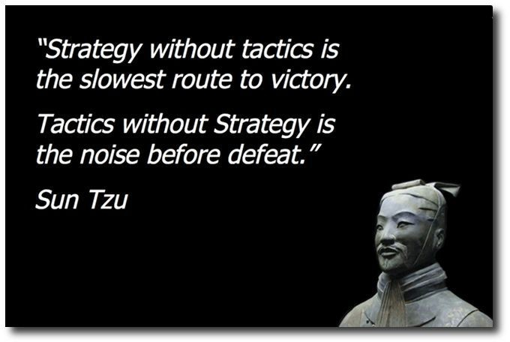

What is Strategy?
“Strategy” is a concept that comes originally from warfare;

Slide 13
A formal Definition…
A detailed definition is offered by Johnson & Scholes (1993):
‘Strategy is the direction and scope of an organisation over the long-term: which achieves advantage for the organisation through its configuration of resources within a challenging environment, to meet the needs of markets and to fulfil stakeholder expectations’.
Johnson G. and Scholes K. (1993) Exploring Corporate Strategy (Prentice Hall)

Slide 14
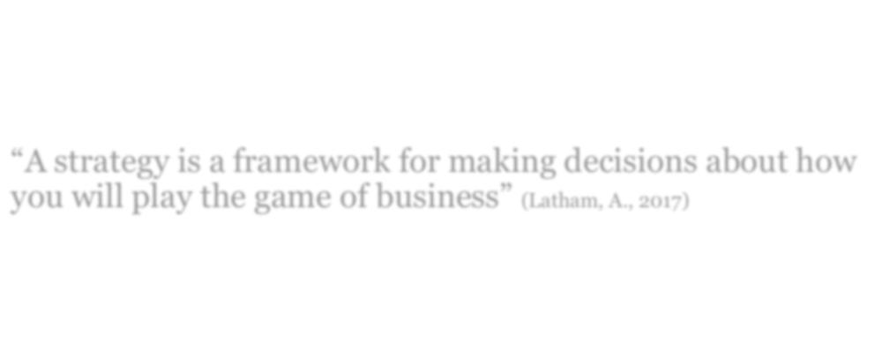
Forbes says…
“A strategy is a framework for making decisions about how you will play the game of business” (Latham, A., 2017)
https://www.forbes.com/sites/annlatham/2017/10/29/what-the-heck-is-a-strategy-anyway/

Slide 15
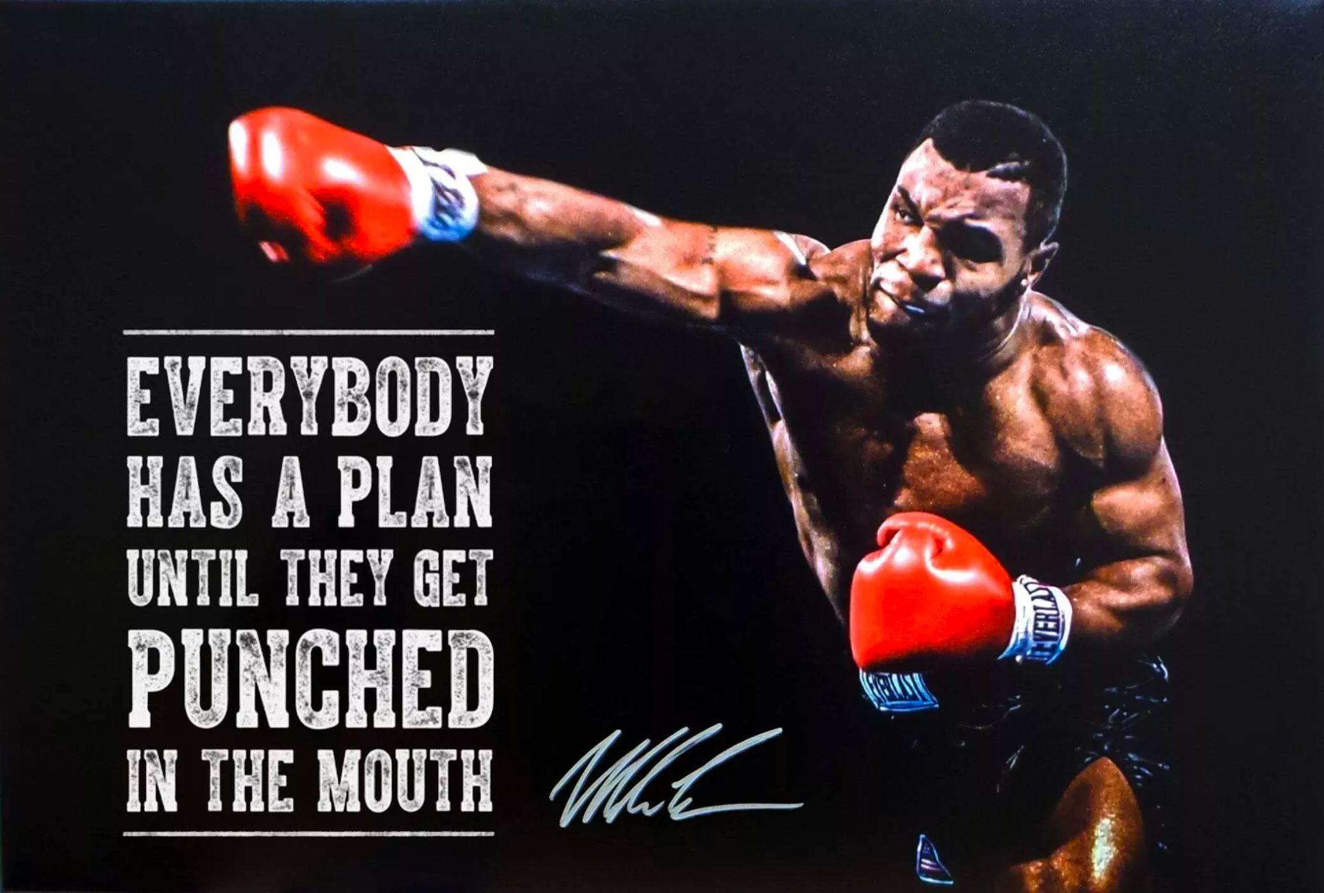

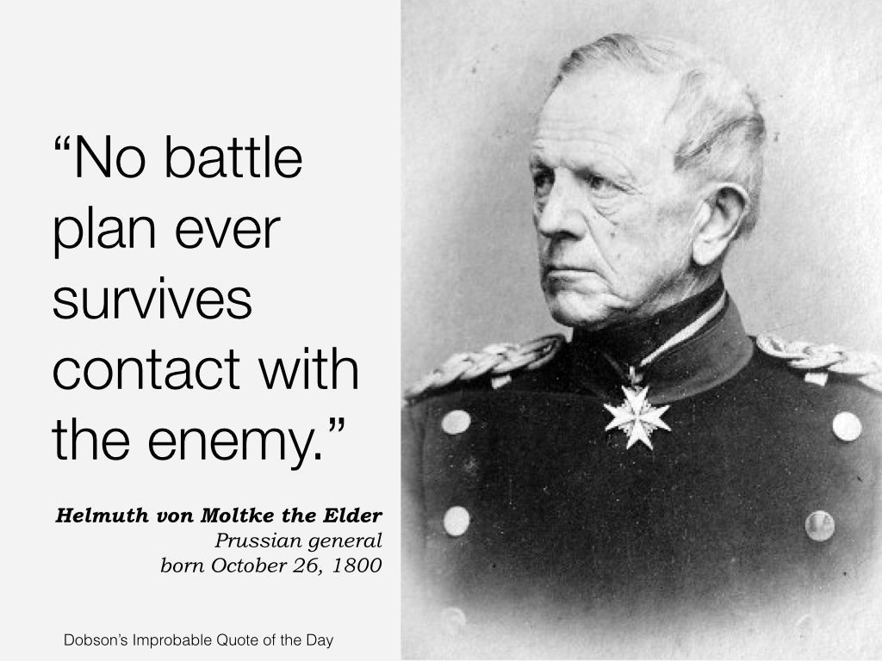
Plan vs Strategy…?

Slide 16



Strategy / Plan / Goal
Goal – Where you want to get to
Strategy = General idea of how to get there
Plan = How to implement the strategy in reality / more specific detail

Slide 17
Example…
Goal – ‘I want to achieve my Diploma!”
Strategy - Attend classes, time-manage assignments, study effectively
Plan -
Attend all classes
Get proper rest so I can focus Analyse assignments when issued Prioritise tasks
Allocate time & resources
Contact library and get research tips Identify good resources

Slide 18
What Business wants from a Strategy…
When an organisation invests in a new technology, or decides on a new strategy, what do they want to see as a result?
POSITIVE RESULTS!! For example, a “Return on Investment”
In English – “How much will I make on this?” / “What’s my profit here?”

Slide 19
Business Measures
An organisation will often (if not always) use a range of financial measures to gauge the success of an investment
AND/OR – to decide whether to invest in the first place!

Slide 20

Business Measures
Some of the Financial measurements used by organisations are:
“Cost – Benefit Analysis”
“Return On Investment”
“Break-even Analysis”
Good News - This is not a Finance module so you do not need to learn any Financial formulae

Slide 21

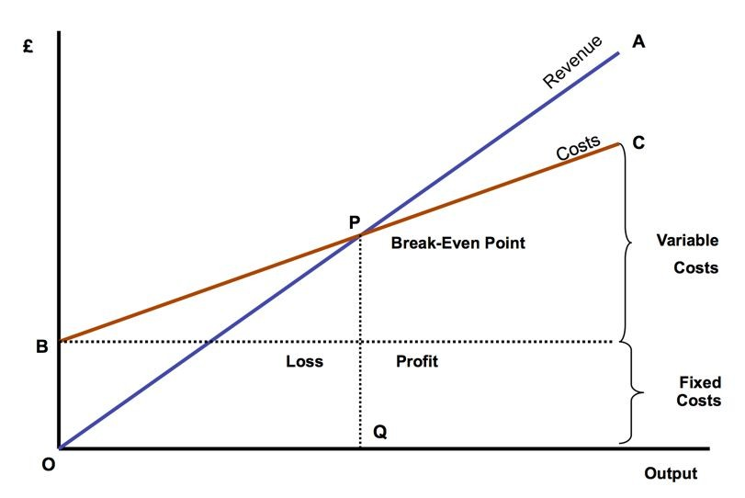
Breakeven – Finance & Strategy

Slide 22
Questions?

Slide 23

Use of IT for a Competitive Advantage
In what ways do companies use IT to help gain a competitive advantage?

Slide 24

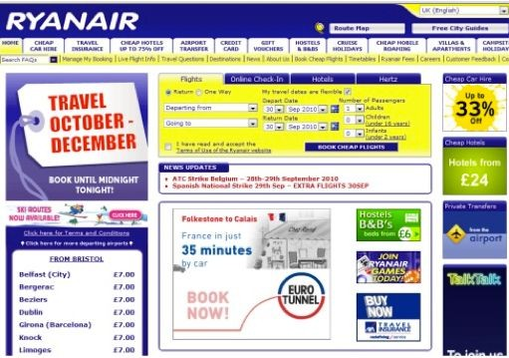
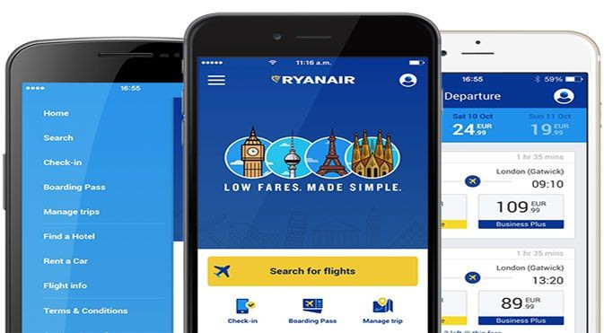
Example - Ryanair
Air Travel was expensive
Existing competitors - high brand awareness & market dominance
Holiday makers booked through Travel Agents who were ‘linked’ to specific airlines
How did Ryanair use IT to gain a competitive advantage?

Slide 25

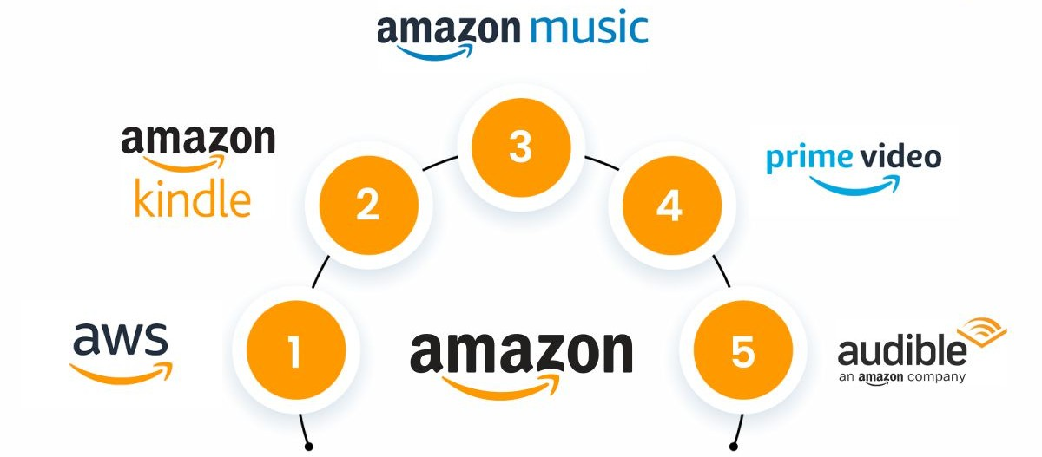

Example 2 - Amazon
The existing industry relied upon (to a reasonable extent) “high street” shops for sales
Logistic costs were high – delivering product to shops
Rent costs were high – shops tend to be in city centres
Markets were limited – customers have to get to a shop to buy a product
How did Amazon use IT to gain a competitive advantage?

Slide 26

Example 3 - Lego
The brand had become “old” in the toy market
New products, especially computer based, were taking market share
LEGO strategy – How did they utilise IT?

Slide 27
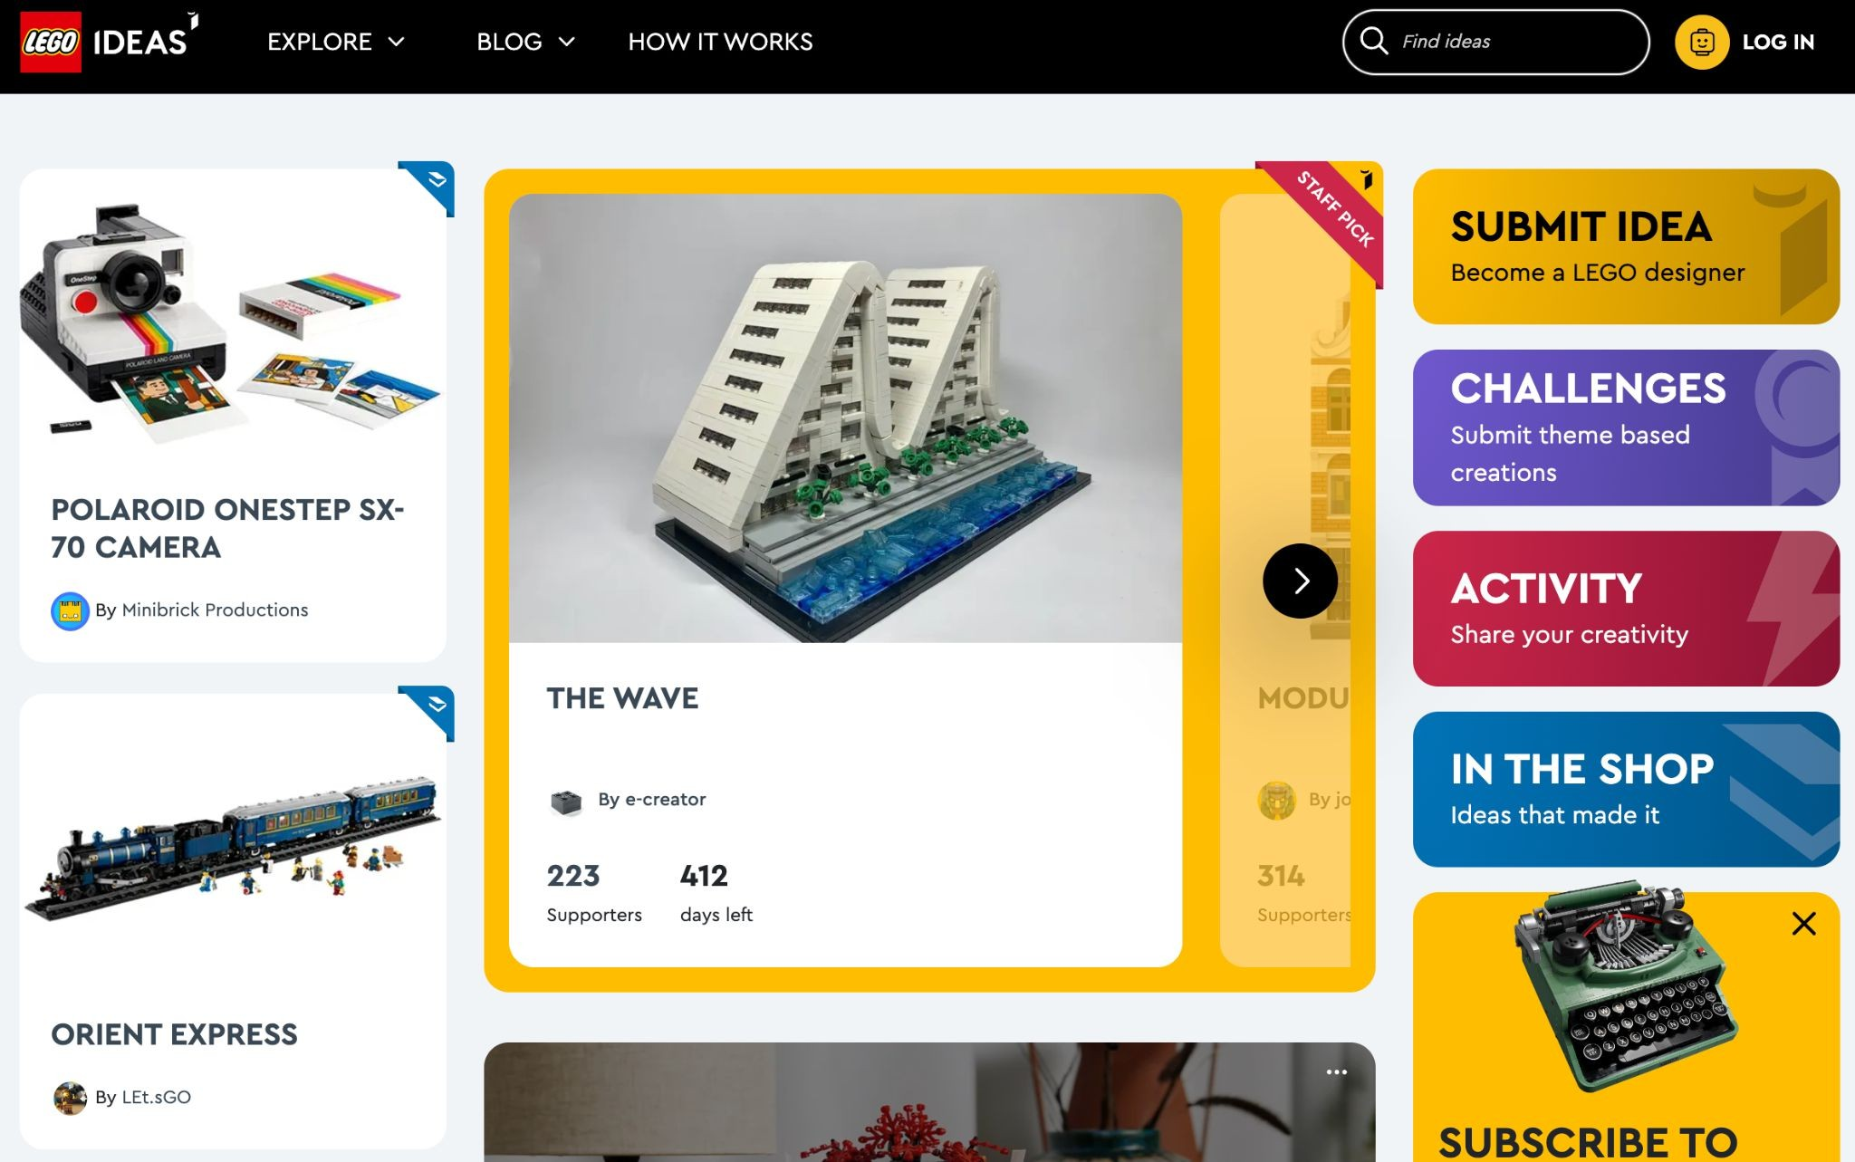
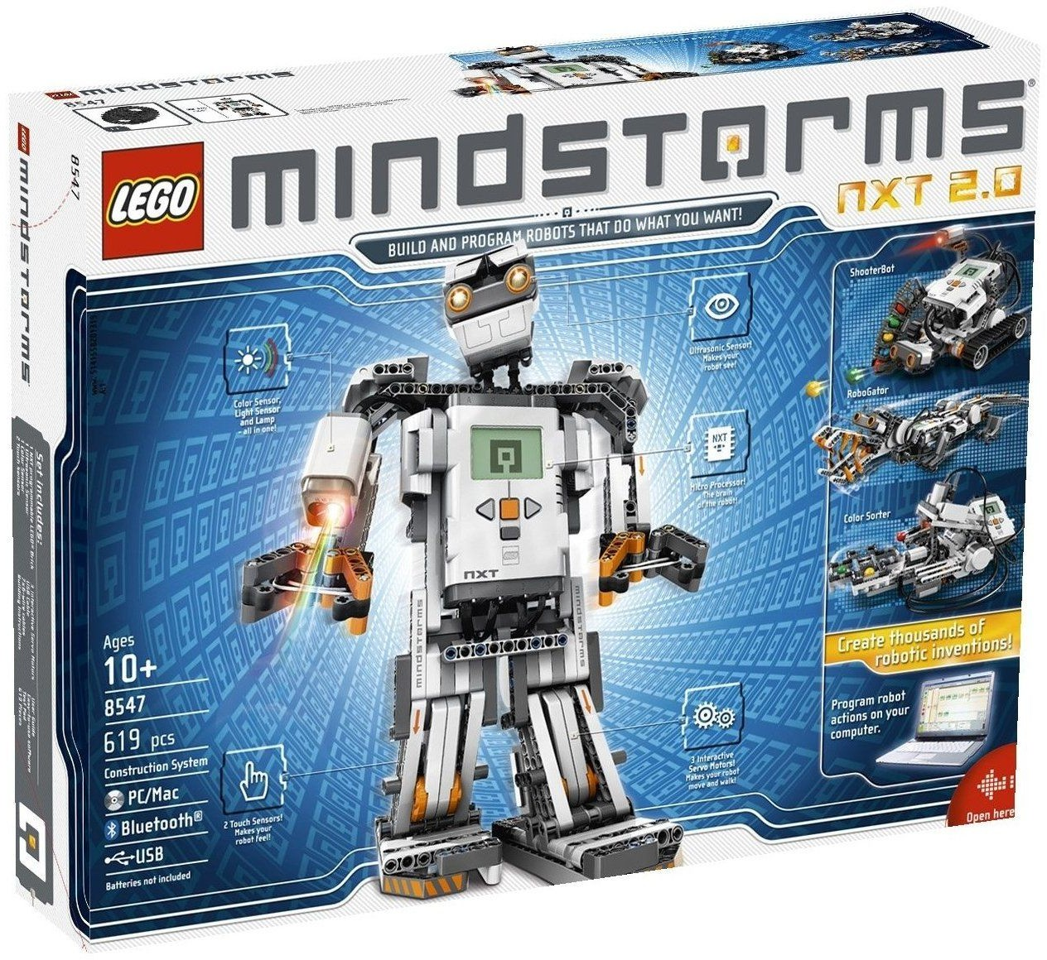


Slide 28
Group Activity!
Choose a company and discuss examples of strategic decisions that this company would typically make at;
  Corporate Level (i.e. CEO / Senior Executives),
  Business Level (i.e. local business unit / specific department), and
  Functional Level (i.e. dealing specifically with customers / clients)

Slide 29






Slide 30
Questions?

Slide 31


